Slide 1
Interactive Report Building using Power BI
Harshvardhan Saini

Slide 2

Interactive Report building using Power BI
Harshvardhan Saini

Slide 3




Harshvardhan Saini Architect, Technology | Nagarro Software, Gurgaon
harsh.saini@nagarro.com
https://www.linkedin.com/in/sainiharshvardhan/
@airwings17
This Photo by Unknown Author is licensed under CC BY-SA
This Photo by Unknown Author is licensed under CC BY-SA

Slide 4
Session Agenda
Familiarize with Power BI Desktop Tool
Focus on available options in Power BI for basic and advance operations

Slide 5
Data Modeling and Reporting
Power BI - Big Picture
Data Collection Options
Simple Report from Start to End
Data Modeling - Exploring Query Editor
Data Modeling - Exploring Query Editor menu
Data Modeling – Manage Relationships
Data Modeling – Columns vs Measures
Data Modeling - Filters and Formulas
Reporting - Create Report
Power BI - As a Utility

Slide 6
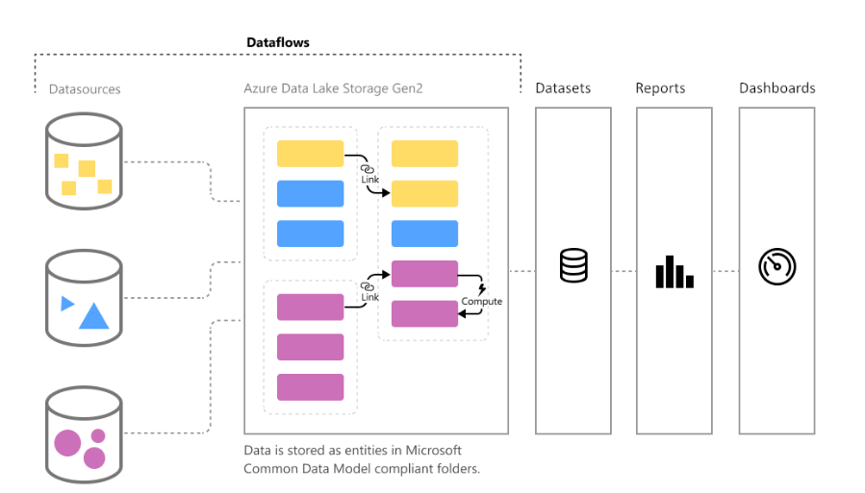
Power BI – Big Picture

Slide 7
Power BI –Data Collection Options
File access
Local file system, One drive
Database
On-premises, cloud
Power Platform
Azure
Azure data lake, Azure cloud databases
Online services
Web
URL Resources, Odata Feeds

Slide 8
Simple Report from Start to End
Understanding the Sample Data structure
File access
Load Data
Add Chart
Change default sum to Count (distinct)
Format -> Turn on Data labels

Slide 9
Demo :Displaying a simple end to end flow
Notes:
10 mins

Slide 10
Data Modeling – Exploring Query Editor
Operation on whole table
Use first row as header
Add Index column
Reorder
Operation on columns
Change Data Types
Transform
Lowercase, Uppercase, Trim, etc.

Slide 11
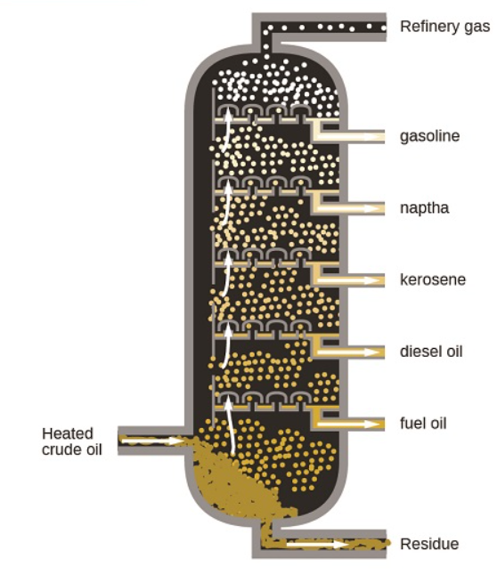
Data Modeling – Exploring Query Editor
Data Cleaning
Remove unnecessary column
Rename columns
Filtering and Sorting
Remove Duplicate
Etc.
Applied Steps
Inject Step in the middle

Slide 12
Demo : Exploring Query Editor
Notes:
10 mins

Slide 13

Data Modeling - Exploring Query Editor menu
Home
Transform
Add Column
View

Slide 14
Demo : Data Modeling - Exploring Query Editor menu
Notes:
25 mins

Slide 15
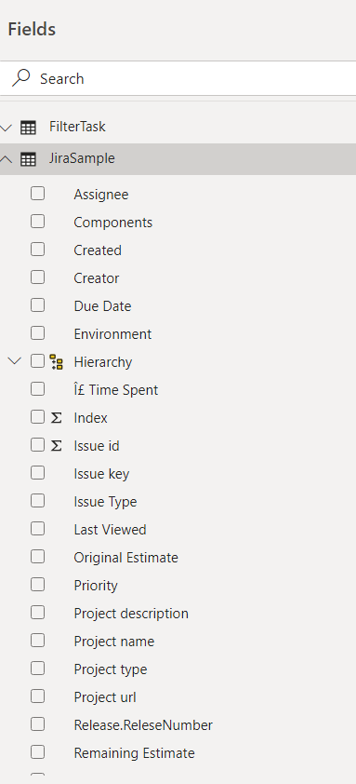
Data Modeling – Manage Relationships
Manage Relationships
Displaying a related columns

Slide 16
Demo : Manage relationships and displaying a related column

Slide 17
Data Modeling – Columns vs Measures
The difference is the context of evaluation. A measure is evaluated in the context of the cell evaluated in a report or in a DAX query, whereas a calculated column is computed at the row level within the table it belongs to
Column
Evaluated for each row in your table
Saved back into the model so take up space
Usually does not make sense when used as a single entity e.g. “Is SLA Met”
Measure
Evaluated when you use it in a visual, when the visual is rendered
Not saved anywhere
Usually make sense even when used individually e.g. “Total votes”

Slide 18
Demo : Understanding Column vs Measure

Slide 19
Data Modeling - Filters and Formulas
DAX (Data Analytics Expression)
All ( [<table> | <column>[, <column>[, <column>[,…]]]] )
Clears all filters
e.g. Calculating percentage
SUM (<column>)
SUMX (<table, <Expression>)
Filter (<table>,<filter>)
Returns a table that represents a subset of another table or expression
Reduce the number of rows in the table that you are working with
FILTER is not used independently

Slide 20
Data Modeling - Filters and Formulas
Calculate (<expression>,<filter1>,<filter2>…)
Single filter or multiple filters
Overrides incoming filter
e.g.
Filtered Votes = CALCULATE( [RowCount], JiraSample[Labels] =="L1“ )

Slide 21
Demo : Filter and Formulas

Slide 22
Reporting
Using Hierarchy
Using Only Matrix
Moving hierarchy to model
Default summarization
Using a URL
Displaying /Hiding Subtotal
Year To Date
Same Period Last Year

Slide 23
Demo

Slide 24

Power BI - As a Utility
JSON to Table
Unstructured Data to structured Data
Export Data

Slide 25
Demo : Power BI as Utility

Slide 26
References
Docs.Microsoft.com
Pluralsight
https://www.youtube.com/watch?v=SlQJaryCLy4
https://www.youtube.com/watch?v=ewjRItLlgG8

Slide 27
Any Questions?

Slide 28

Please fill out the survey! & Win Swags!!
https://www.powerplatformbootcamp.com/survey

Slide 29
Thank You For Attending

